Slide 1

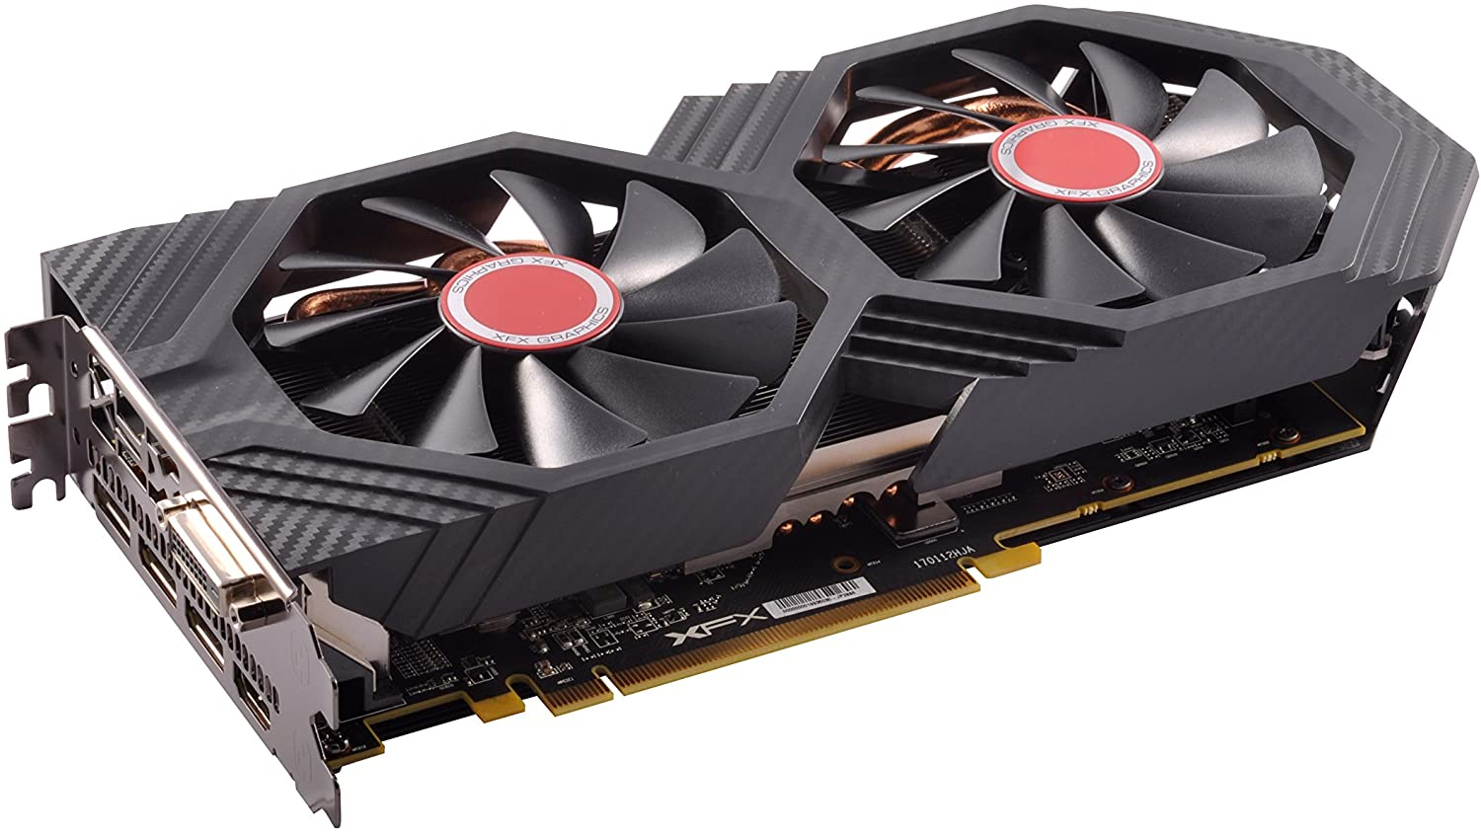
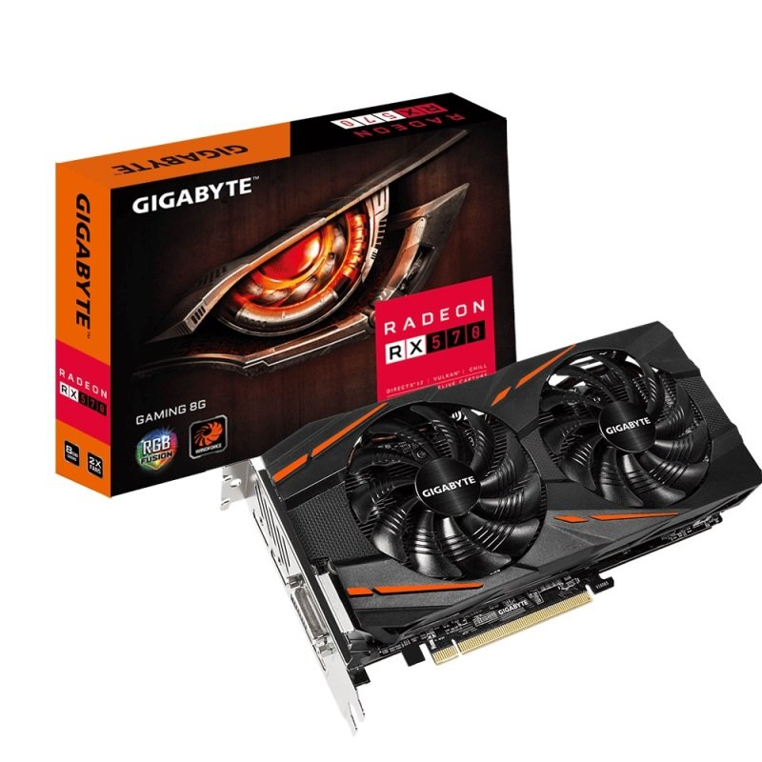
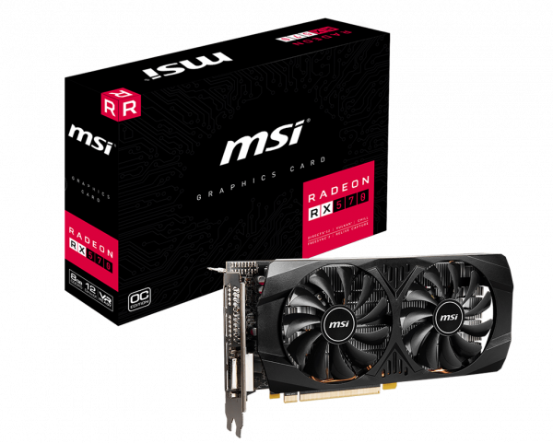
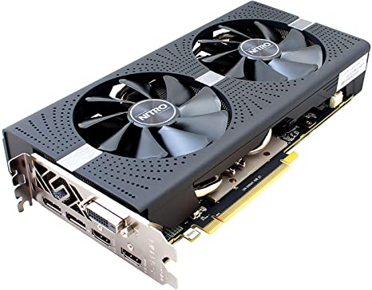
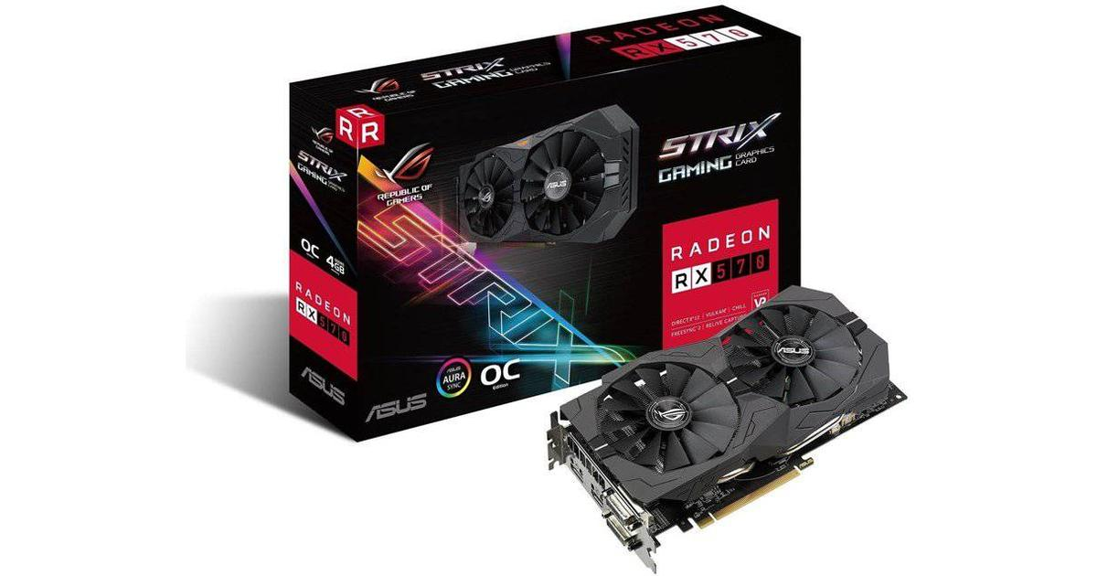
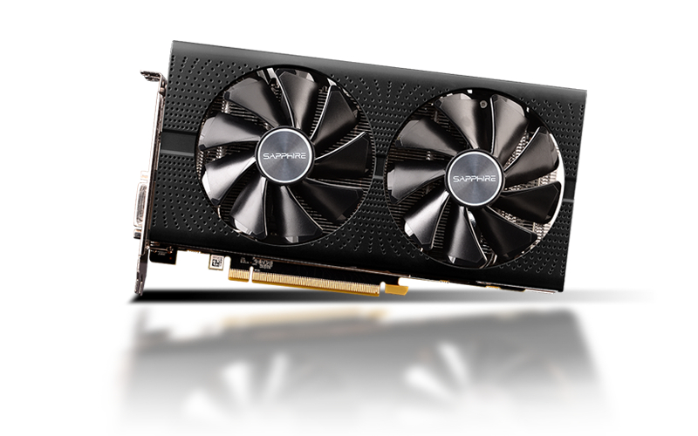
UWL Computer Store
Login |Register |Account
Credit:£400
Contents:
Graphics cards
-AMD
-Nvidia
CPU
-Intel
-AMD
Motherboards
-MSI
-Gigabyte
RAM
-Corsair
-G.Skill
Cases
-NZXT
-Corsair
Storage
-Samsung
-Western Digital
Power Supply
-Corsair
-EVGA
AMD graphics cards
XFX Radeon RX 580 8GB
Gigabyte Radeon RX 570 8GB
MSI Radeon RX 570 8GB
Stock remaining:4 |Read More
Stock remaining:7. |Read More
Stock remaining:2. |Read More
Sapphire Radeon RX 570 4GB
ASUS Radeon RX 570 8GB
Sapphire Radeon RX 580 8GB
Stock remaining:3. |Read More
Stock remaining:6. |Read More
Stock remaining:9. |Read More
Notes:
Add login section after interacting with website

Slide 2
UWL Computer Store
Login |Register |Account
Credit:£400
Contents:
Graphics cards
-AMD
-Nvidia
CPU
-Intel
-AMD
Motherboards
-MSI
-Gigabyte
RAM
-Corsair
-G.Skill
Cases
-NZXT
-Corsair
Storage
-Samsung
-Western Digital
Power Supply
-Corsair
-EVGA
Description:
.
Price:
+
0
-
Add to basket

Slide 3
UWL Computer Store
Login |Register |Account
Credit:£400
Component: |Price:
x
Component: |Price:
x
Component: |Price:
x
Component: |Price:
x
Component price:
Shipping:
Total:

Slide 4
UWL Computer Store
Login:
E-mail:
Password:
Login

Slide 5
UWL Computer Store
Register:
First Name:
Surname:
Email:
Password:
Password confirmation:
Phone Number:
Register

Slide 6
UWL Computer Store
Login |Register |Account
Credit:£400
Account
-Account details
-Payment Information
-Add Credits
Account:
Payment information:
Name on Card:
Card Number:
Expiry date:
Security code:
Billing address:
Address Line 1:
Address Line 2:
City:
Post Code:
Save

Slide 7
WIX

Slide 8


Slide 9
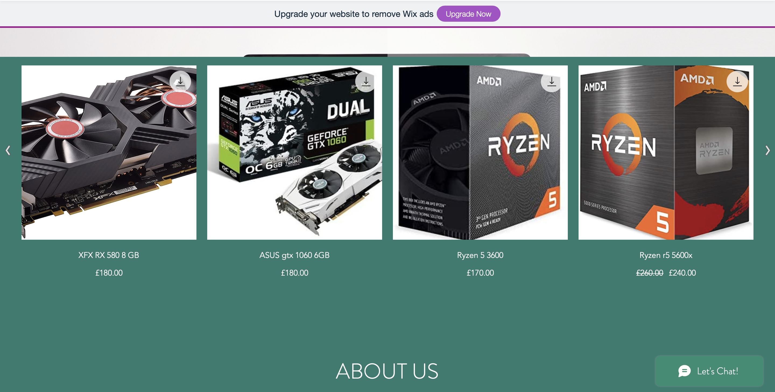

Slide 10
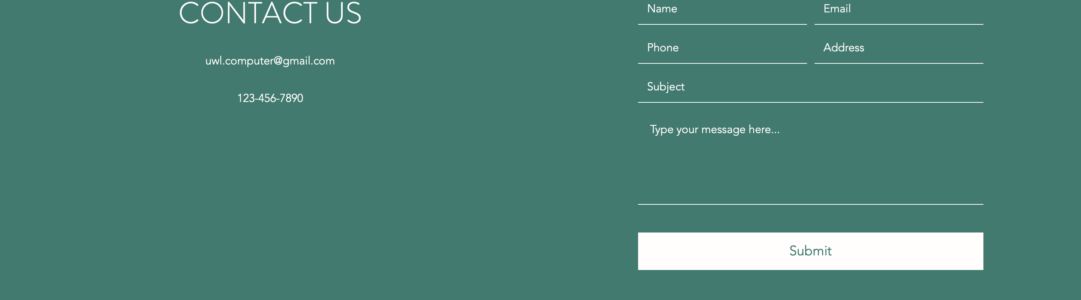

Slide 11
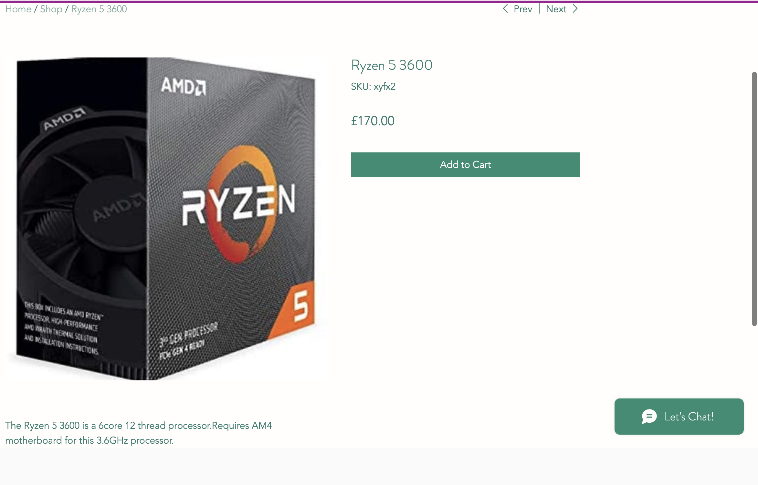

Slide 12
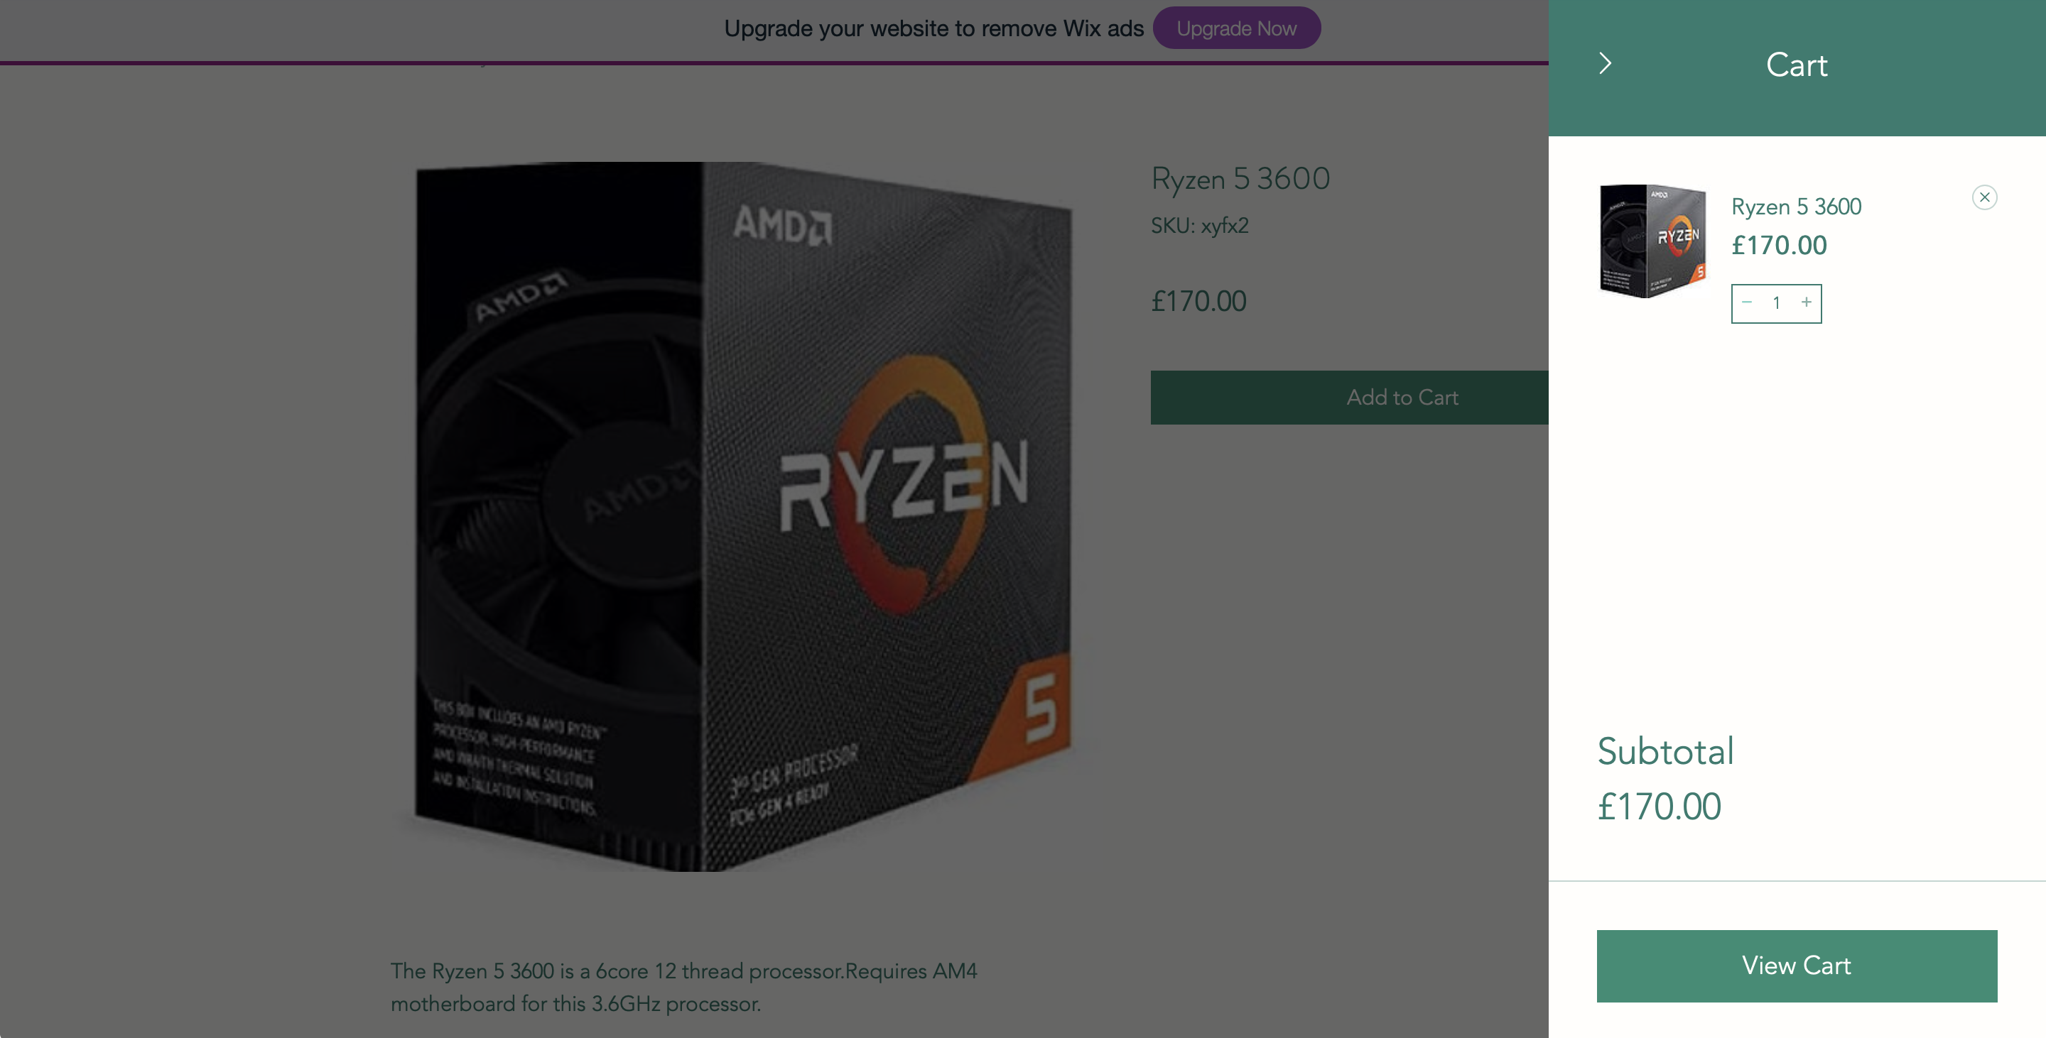

Slide 13
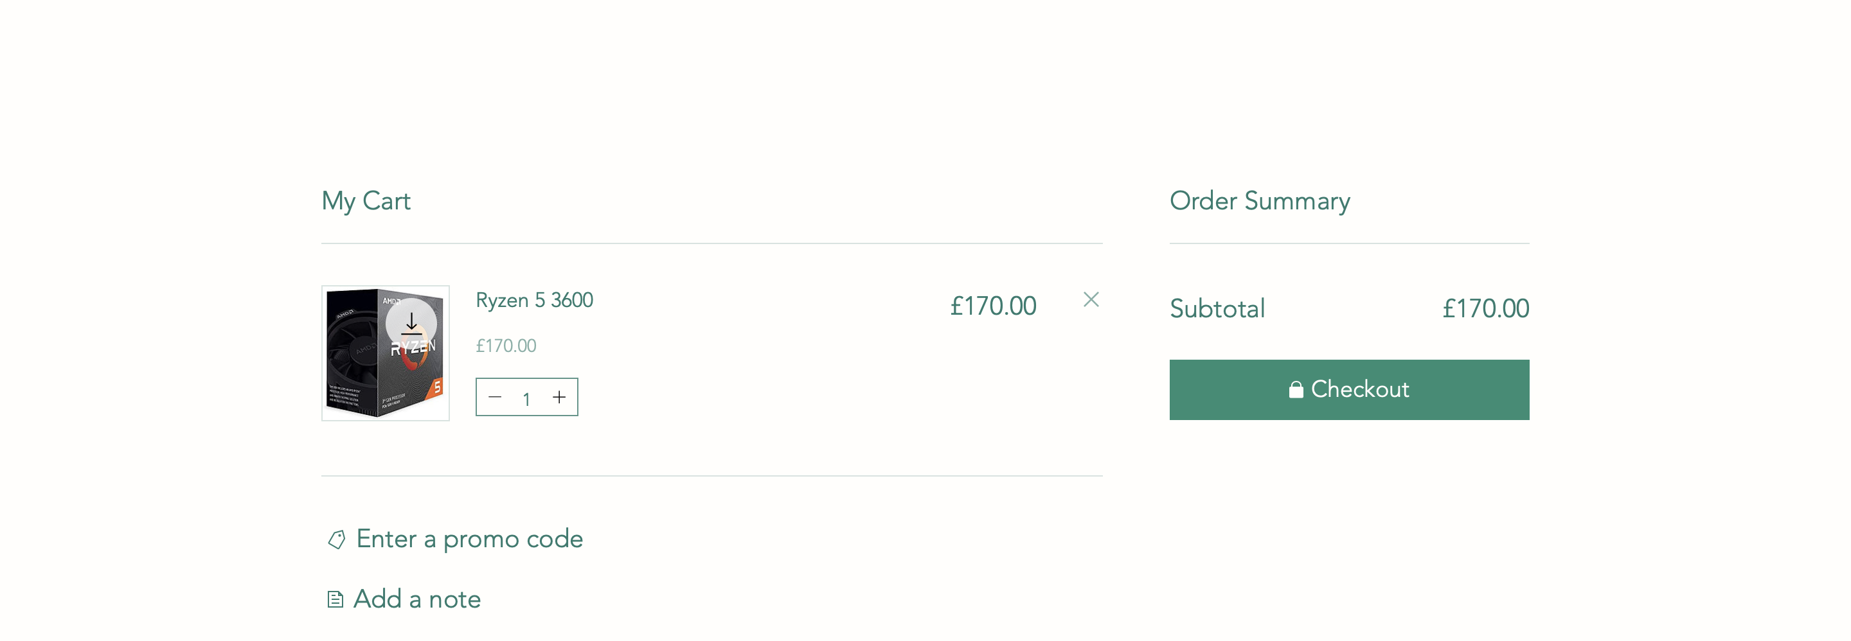

Slide 14
